Slide 1

Prediction of Mean Stratospheric Temperature Over Equator Using LSTM Based Recurrent Neural Network
CS 891 - Project Presentation
Spring Semester 2022
IIIT Kalyani
By -
Subham Pal [404]
Subrata Kumar Biswas [405]
Rajnish Maurya [378]
Under supervision of Dr. Uma Das - Assistant Professor (Physics), IIIT Kalyani.

Slide 2
Topics to cover
Introduction to Atmosphere Layers
Phenomenons happening in the Stratosphere
Relationship among the Atmospheric Pressure, Temperature and Altitude in the Atmosphere (Stratosphere)
Description of Data collected from the Equatorial region from Stratosphere.
Explaining the problem statement
Model used and its Architecture
Metrics and Results

Slide 3
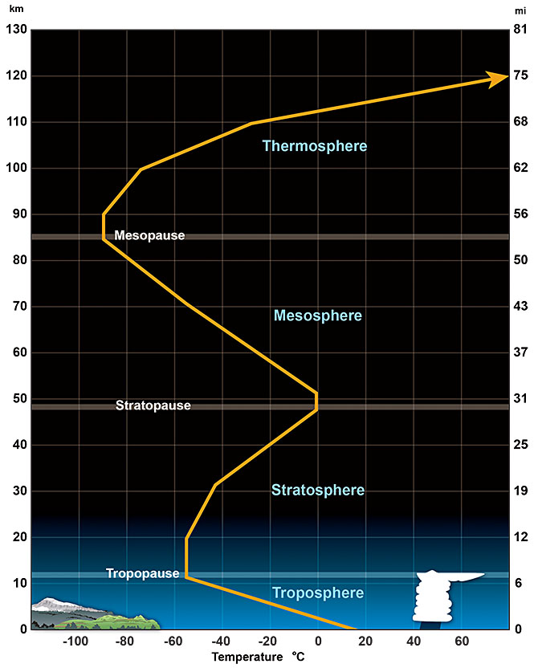
The Atmosphere
Troposphere - 10 KM above the sea level
Stratosphere - 10-50 KM above the sea level
Mesosphere - 50-80 KM above the sea level
Thermosphere & Ionosphere - Beyond 80 KM
Stratosphere: Temperature is increasing with altitude in the Stratosphere.
Quasi-biennial oscillation: A belt of strong winds move around the earth. After every 14 months, the wind completely changes its direction, whole cycle takes around 24-28 months in a periodic manner - known as Quasi Biennial Oscillation.
[Credit: https://www.weather.gov/jetstream/layers]

Slide 4
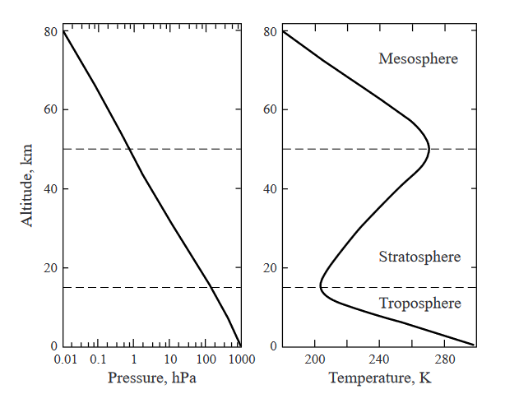
The problem statement
1 HPa - 250 HPa lies in the the Stratosphere.
Data containing the mean Temperature on the Equator in Kelvin for various Pressure regions. (1979-2020)
1 HPa
250 HPa
[Credit: Harvard.edu]

Slide 5
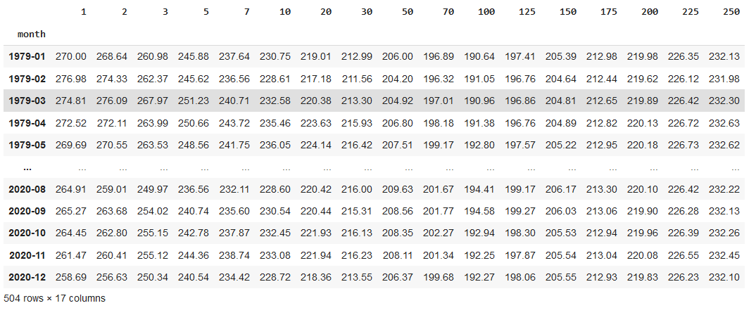
The problem statement
Pressure levels in HPa
Build a Deep Learning Model capable of multivariate Time Series prediction.
Predict the values of upcoming years and verify the performance of model.

Slide 6
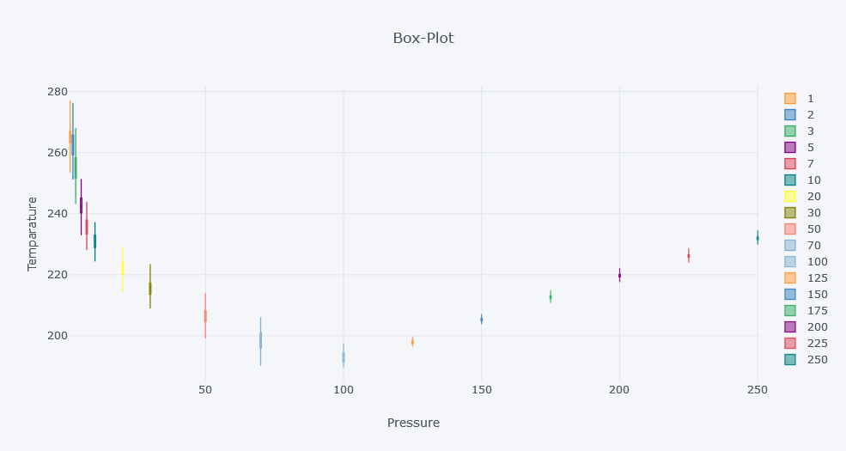
Box Plot - Pressure vs Temperature
In kilokelvin (kK)
(In HPa)

Slide 7
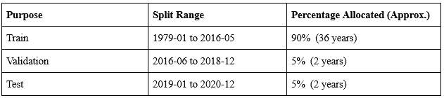
Train, Validation & Test
Train Set: Used to train the model.
Validation Set: Test whether our model is Overfitting or Underfitting.
Test Set: Verify final prediction.

Slide 8
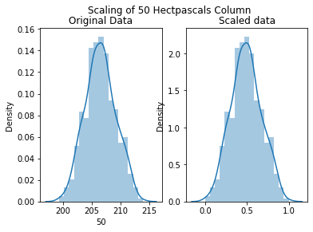
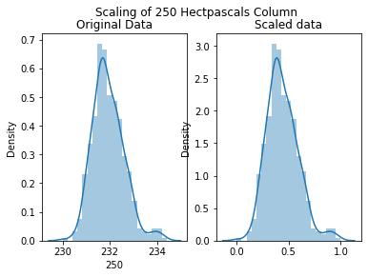
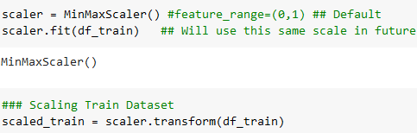
Scaling of Dataset
Scaling is chosen instead of normalization.
Min-Max Scaler is used for scaling.
The data has been scaled to the range [0,1]
Min-Max scaler got optimised with the training set, which makes it independent with the validation and test data.

Slide 9

Generating Time Series for TRAIN Set
X_train
(444, 5, 17)
5 Rows Input
Slide by one row at a time
2 Rows Predict
y_train
(24, 2, 17)
Rows of Data with 17 Features

Slide 10
Generating Time Series for Validation Set
X_test
(24, 5, 17)
5 Rows Input
Slide by one row at a time
2 Rows Predict
y_test
(24, 2, 17)
Rows of Data with 17 Features

Slide 11
Training of LSTM Model
X_train
(444, 5, 17)
LSTM Model
Training Process
Training Data
X_test
(24, 5, 17)
y_train
(24, 2, 17)
Validation Data
y_test
(24, 2, 17)

Slide 12
LSTM Model
LSTM Model
(Trained & Ready for Prediction)
INPUT
(1, 5, 17)
OUTPUT
(1, 2, 17)
PREDICTED
10 Rows of Data as Input having 18 Features.
5 Rows of Data as Output having 18 Features.

Slide 13
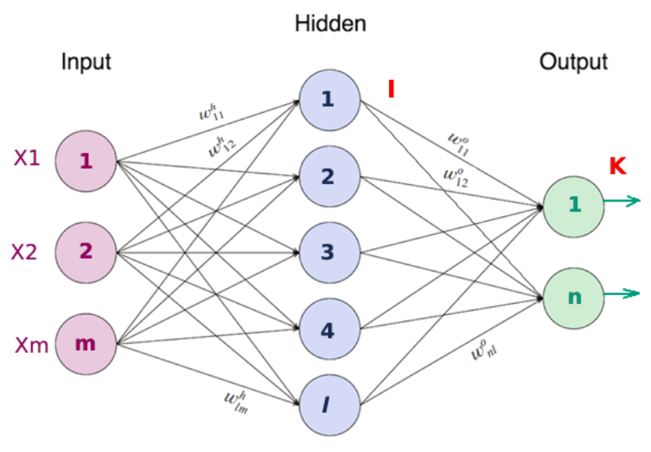
Long Short Term Memory (LSTM)
A type of RNN
Consists of an input layer, a hidden layer and an output layer.
Useful for predictions in timeseries problems.
LSTM are used to avoid the long term dependency problems.In sequence to sequence problems, linear order dependencies in sequences.

Slide 14
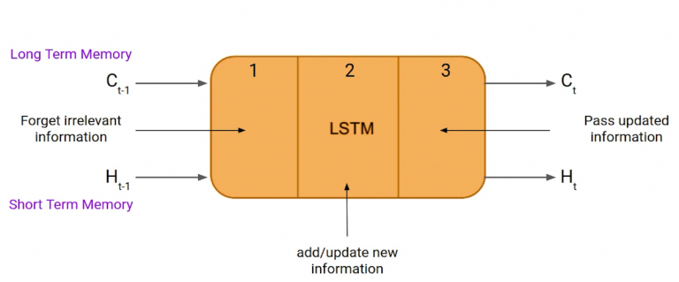
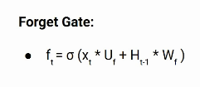
LSTM Architecture
LSTM consists of three gate:
Forget gate , Input gate and Output gate.
Forget Gate
In a cell of the LSTM network , the first step
is to decide whether we should keep the
information from the previous timestamp or
forget it.
Xt: input to the current timestamp.
Uf: weight associated with the input
Ht-1: The hidden state of the previous timestamp
Wf: It is the weight matrix associated with hidden state

Slide 15


Input Gate
Input gate is used to quantify the importance of the new information carried by the input.
Xt: Input at the current timestamp t
Ui: weight matrix of input
Ht-1: A hidden state at the previous timestamp
Wi: Weight matrix of input associated with hidden state
Output Gate
Equation of the output gate is similar to the previous gates.
Its values lies between 0 and 1 because of the sigmoid function.To calculate the current hidden state we will use the output gate and tanh of the updated cell state.

Slide 16
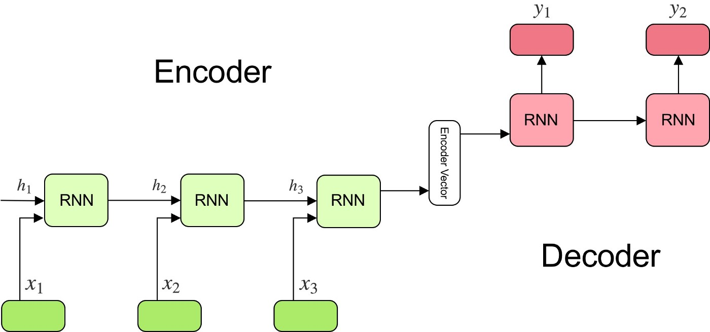


Encoder Decoder LSTM Model
The model consists of 3 parts: encoder, intermediate (encoder) vector and decoder.
Encoder:A stack of several recurrent units (LSTM) where each accepts a single element of the input sequence, collects information for that element and propagates it forward.Each word is represented as x_i where i is the order of that word.
Encoder Vector:This is the final hidden state produced from the encoder part of the model. It is calculated using the formula.
It acts as the initial hidden state of the decoder part of the model
Decoder: Each recurrent unit accepts a hidden state from the previous unit and produces and output as well as its own hidden state.Any hidden state ht is computed using the formula:

Slide 17
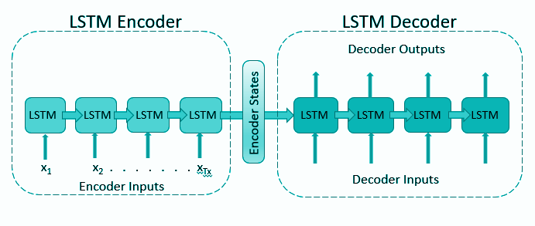
Encoder Decoder LSTM: Model E1D1
Input Shape ( , 5,17)
Output Shape ( , 2,17)

Slide 18
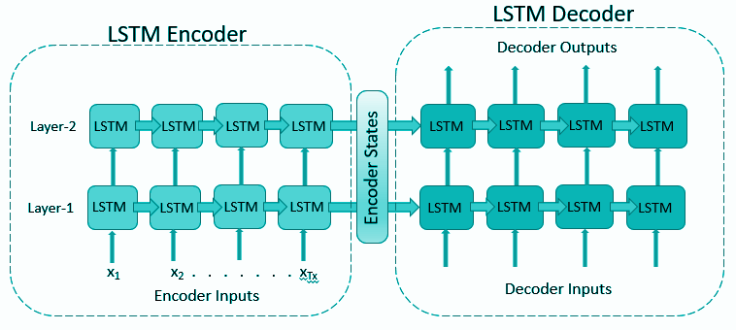
Encoder Decoder LSTM: Model E2D2
Input Shape ( , 5,17)
Output Shape ( , 2,17)

Slide 19
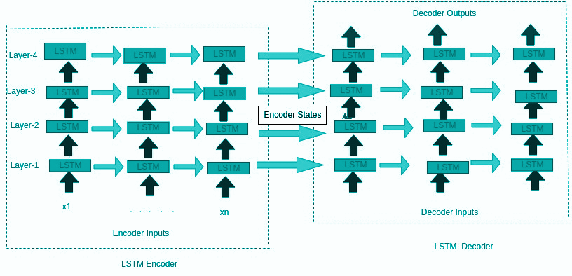
Encoder Decoder LSTM: Model E4D4
Input Shape ( , 5,17)
Output Shape ( , 2,17)

Slide 20
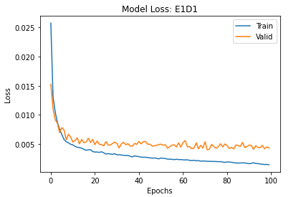

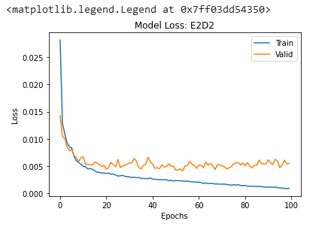
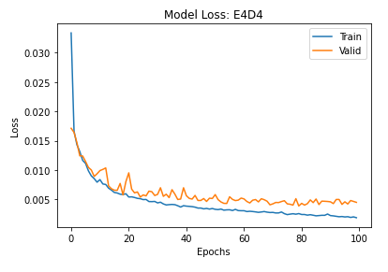
Model Summary
Verdict: E1D1 is doing better.

Slide 21
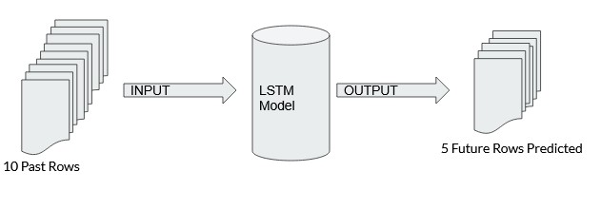
How To Predict 24 Months?
Our Model is Trained to predict only 2 future samples (months), BUT according to our problem Statement we need to predict next 24 months.
We will be using Multi-Step Prediction Method

Slide 22
Multi-Step Prediction Method.
Direct Multi-step Forecast Strategy
prediction(t+1) = model1(obs(t-1), obs(t-2), ..., obs(t-n))
prediction(t+2) = model2(obs(t-2), obs(t-3), ..., obs(t-n))
Recursive Multi-step Forecast Strategy
prediction(t+1) = model(obs(t-1), obs(t-2), ..., obs(t-n))
prediction(t+2) = model(prediction(t+1), obs(t-1), ..., obs(t-n))
Direct-Recursive Hybrid Strategies
prediction(t+1) = model1(obs(t-1), obs(t-2), ..., obs(t-n))
prediction(t+2) = model2(prediction(t+1), obs(t-1), ..., obs(t-n))
Multiple Output Strategy
prediction(t+1), prediction(t+2) = model(obs(t-1), obs(t-2), ..., obs(t-n))
Brownlee [2]

Slide 23
Recursive Multi-Step Forecast
Blue -> Input in Model
Green -> Output from Model
Red -> Final Predicted Value.
These Recursive Steps Continue….

Slide 24
Description of metrics
Pearson Coefficient is the measure of relationship between two variables.
Root Mean Squared Error (RMSE) is the root square of the average of the squared difference between the predicted and actual values.
Mean Absolute Error (MAE) is the average of the absolute differences between the predicted and actual values.
Mean Absolute Percentage Error (MAPE) is the average of the percentage errors between the predicted and actual values. It calculates the relative error in observations.
R-squared score shows how good our model fits the datasets.

Slide 25
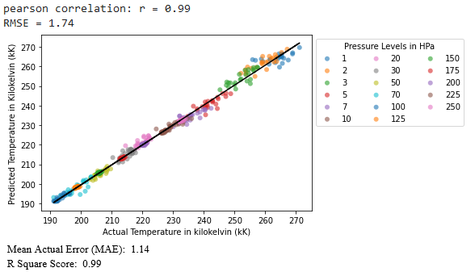
Results: Tallying With Actual Test Data

Slide 26
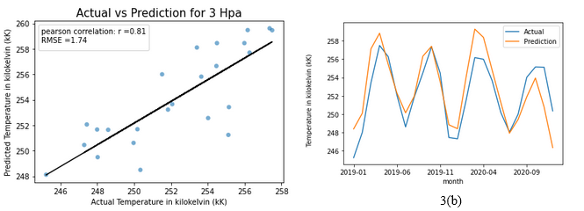
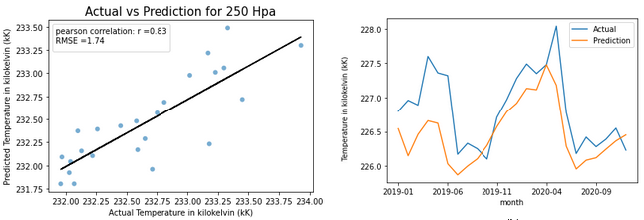
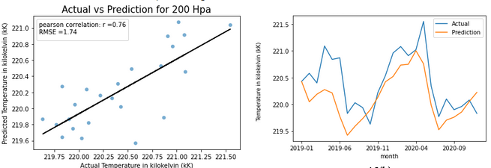
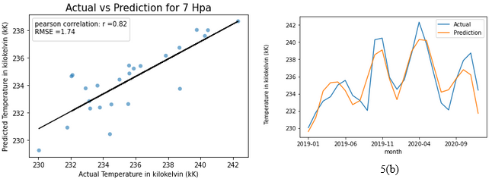
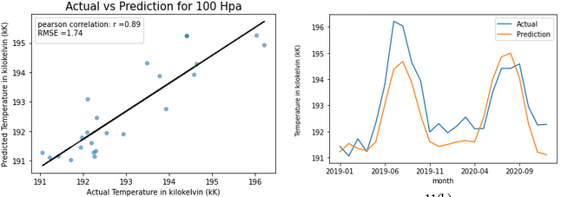
Results: Tallying With Actual Test Data

Slide 27
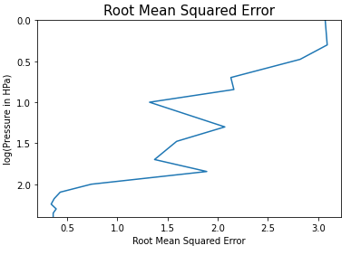
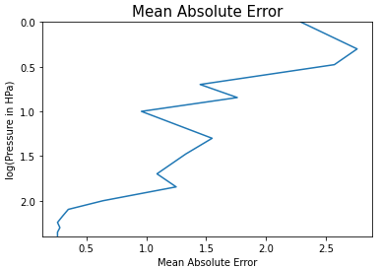
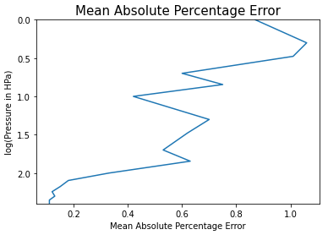
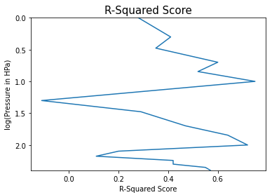
Accuracy Wrt. Altitude
As we go higher in the atmosphere, the errors in our results increases.
The model fits the data good at first and then the fitting degrades and then again increases.

Slide 28
Conclusion
As can be seen in the results, our model performed well and it was close to the actual values.
The predictions of climatic changes often have very blunt accuracy because there are many natural factors that plays their role in controlling the weather.
But, our results shows that LSTM Models are a good approach to predict such long timely data. If added more factors, they can yield more accurate results.

Slide 29
Future Scope
Since we predicted the temperatures in stratosphere, we can track the global warming alerts using the predicted values for upcoming years.
Our model worked well, so we can create similar models to predict other natural climatic events such as rainfall, cyclonic winds,etc.

Slide 30
A Brief Summary
Introduction to Atmosphere Layers (Stratosphere)
Description of Data collected from the Equatorial region from Stratosphere.
Explaining the problem statement
Model used and its Architecture
Metrics and Results

Slide 31
Acknowledgements
We would like to to thank our project supervisor, Dr Uma Das for her support throughout the semester.
She provided us with the dataset without which this project would not have been possible.

Slide 32
References
Hersbach, H., Bell, B., Berrisford, P., Biavati, G., Horányi, A., Muñoz Sabater, J., Nicolas, J., Peubey, C., Radu, R., Rozum, I., Schepers, D., Simmons, A., Soci, C., Dee, D., Thépaut, J-N. (2019): ERA5 monthly averaged data on pressure levels from 1979 to present. Copernicus Climate Change Service (C3S) Climate Data Store (CDS), 10.24381/cds.6860a573. DOI: 10.24381/cds.6860a573
Brownlee, Jason. 2020. Machine Learning Mastery With Python. N.p.: Jason Brownlee.
M. P. Baldwin,L. J. Gray,T. J. Dunkerton,K. Hamilton,P. H. Haynes,W. J. Randel,J. R. Holton,M. J. Alexander,I. Hirota,T. Horinouchi,D. B. A. Jones,J. S. Kinnersley,C. Marquardt,K. Sato,M. Takahashi (2001). The quasi-biennial oscillation. May, 2001. https://doi.org/10.1029/1999RG000073
Daniel J. Jacob and Loretta J. Mickley, Introduction to Atmospheric Chemistry, Atmospheric Chemistry Modeling Group - Harvard University, Princeton University Press, 1999

Slide 33
Thank You
Special Thanks to all the panelists for their valuable insights and suggestions.

